Slide 1
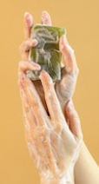
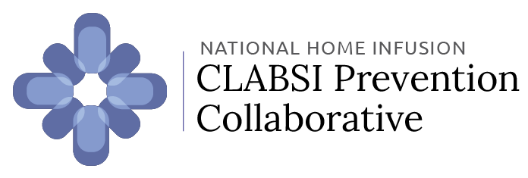
Wash your hands!
Washing your hands for 20 seconds with soap and water or hand sanitizer is the best way to stop the spread of germs!
Everything you touch has germs on it. Here are some times you should wash your hands when you have an intravenous (IV) line.
Before AND after handling your IV line, medications, or supplies
Before AND after cleaning your workspace or SAS(H) mat
Before AND after using gloves
Before AND after cooking or eating
After touching phones, remotes, door handles, etc.
After playing with pets
After using the restroom
Whenever they’re visibly dirty
Disclosure: This project was funded under grant R01HS027819 from the Agency for Healthcare Research and Quality (AHRQ), U.S. Department of Health and Human Services (HHS). The authors are solely responsible for this document’s contents which should not be interpreted as an official position of AHRQ or of HHS.

Slide 2
How to wash your hands
Using soap and water is the best option!
❸
Scrub hands vigorously for
20 seconds
❷
Apply soap to your hands
❹
Rinse
❶
Get your hands wet
❺
Dry
Tips
Scrub your hands while singing the Happy Birthday song twice
Scrub between your fingers and under your nails
If using hand sanitizer, rub your hands until dry. Do NOT wave or blow your hands dry
Wash your hands frequently!

